Slide 1


Alpha Phi Omega
Chi Chapter at UCLA
Alpha Lambda/ Yuna Choi Term, Meeting 1
Feb 26 , 2014
www.apo-x.org

Slide 2
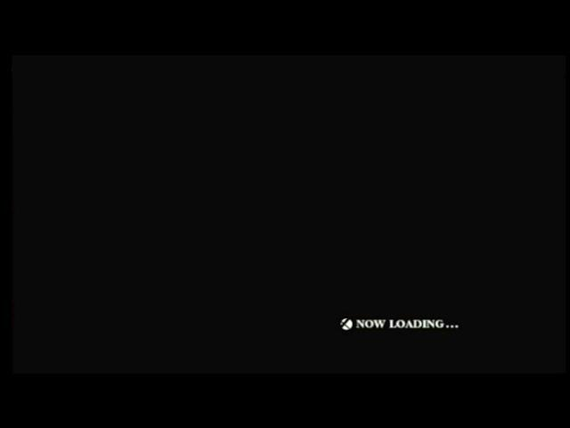

Slide 3
Agenda
1. Officer Updates and Announcements
2. Last Announcements

Slide 4
President
Jessica Suhardjo
president@apo-x.org
Executive Committee
excomm@apo-x.org

Slide 5

Hello :D
- Quick Intro
- Gamer’s Guide

Slide 6
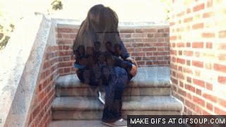
About Me
Pledged AZ Fall 2011
AZ...BRAH!
Oversee and ensure a smooth term :P

Slide 7
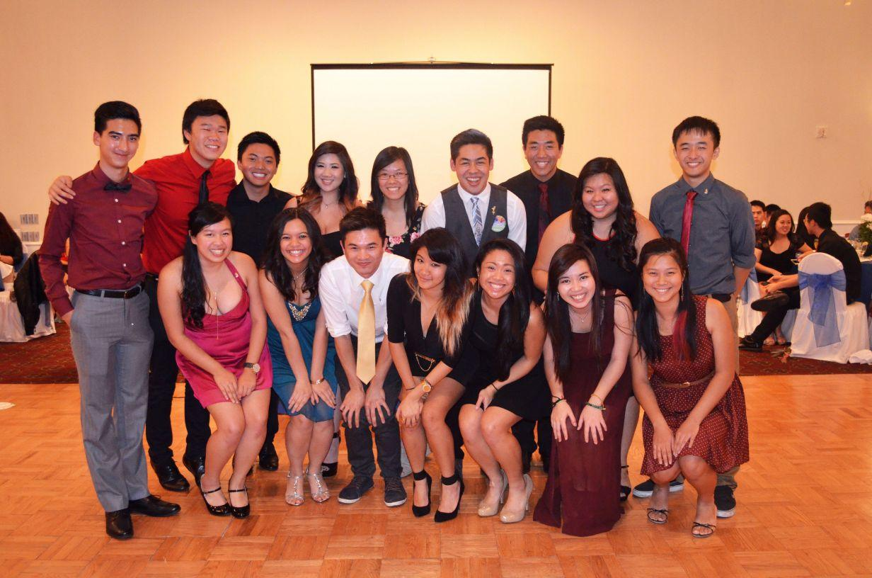
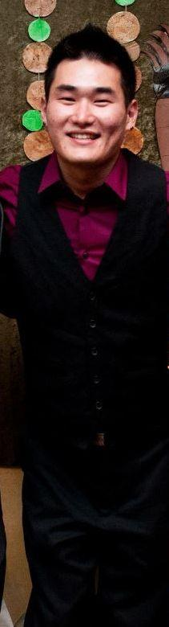
My Committee

Slide 8
Gamer’s Guide Tip #1
“Stop worrying about what
you have to lose and
start focusing on what
you have to gain.”
- Unknown

Slide 9
Administrative VPs
Joseph Chan & Nicola Yip
admin@apo-x.org

Slide 10
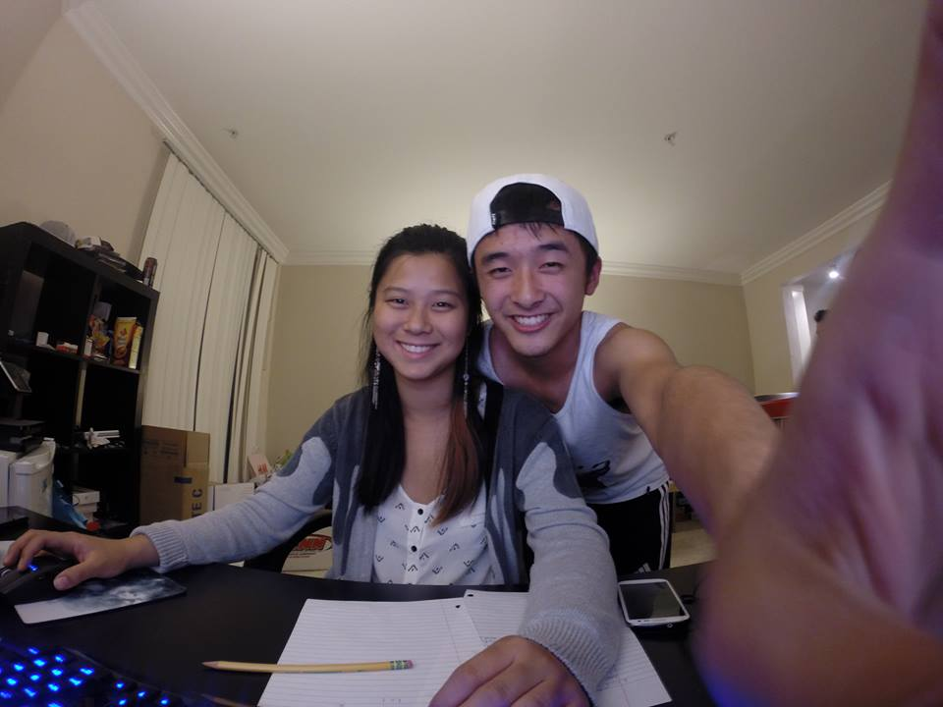
What we do
Deal with anything related to the website
Handle alumni relations
Publicity
Admin-y work

Slide 11
Website information
Pledges should have been emailed on how to log in to the website
If actives want to update their website picture, they can send a new picture to admin@apo-x.org
Actives: if you don’t pay your dues by CM2, we will revoke your website access
Calendar is now hidden if you are not logged in
We will give all bad standing actives website access until CM2 if they ask for their password (will send out email about this)

Slide 12
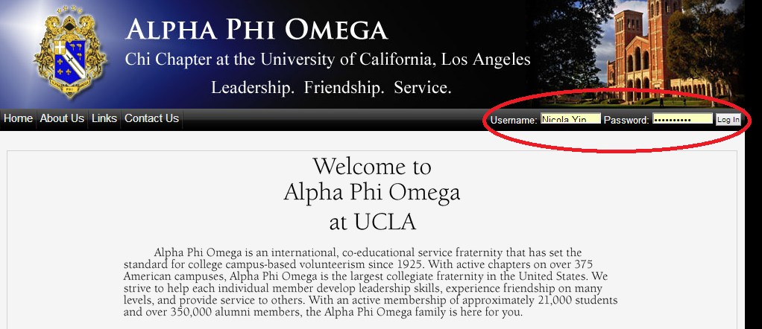
How to sign up for an event
Go to http://www.apo-x.org/

Slide 13
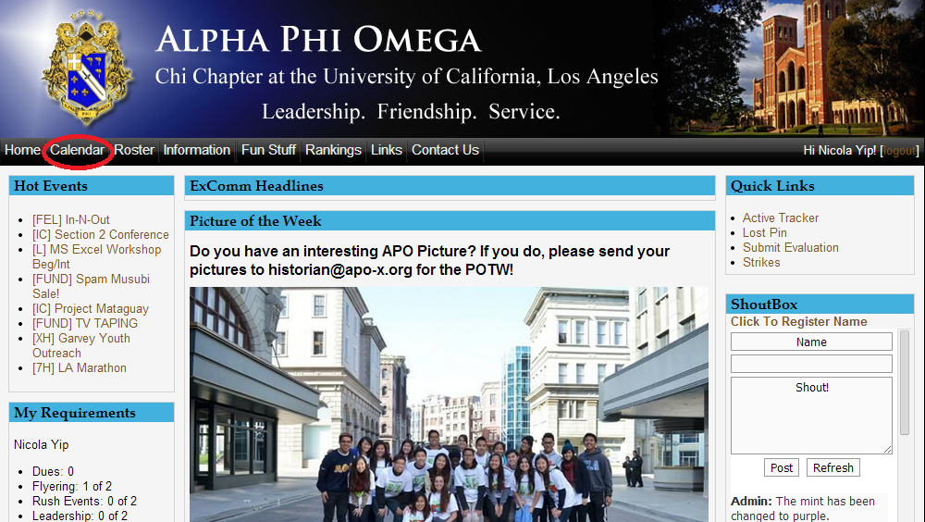

Slide 14
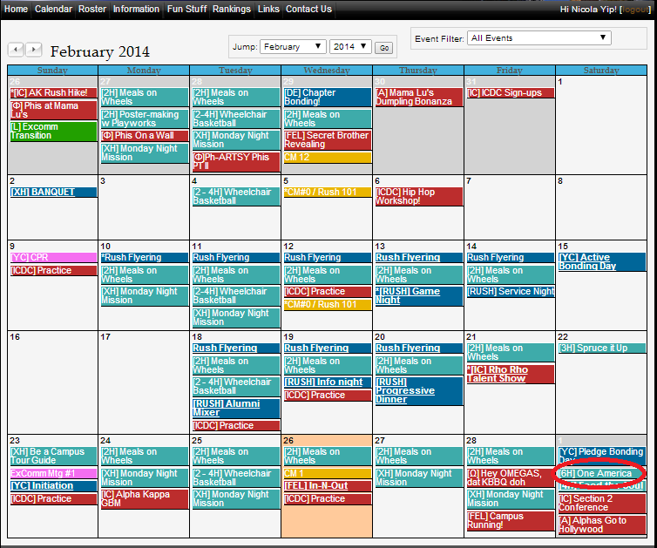

Slide 15
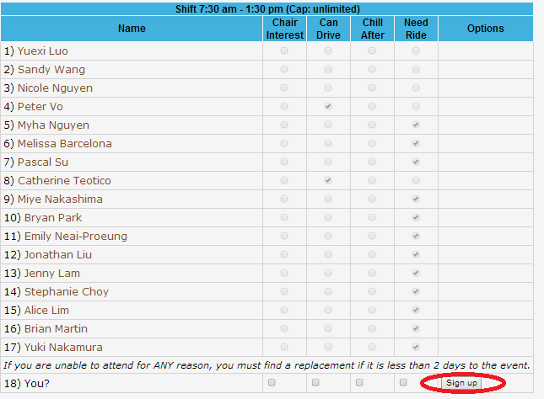

Slide 16
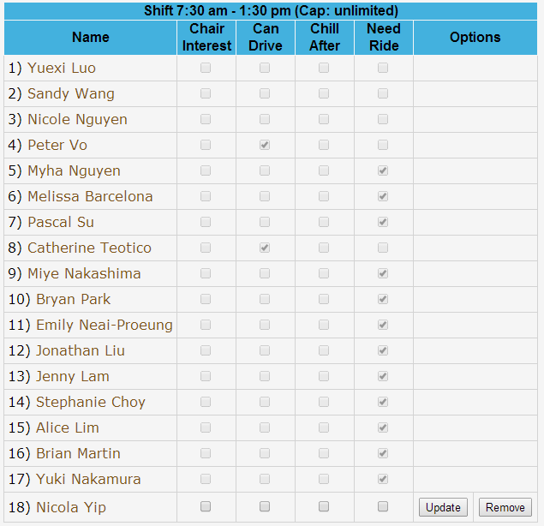

Slide 17

Banner redesign contest!
1 service hour for all participants
2 service hours for winner
Submit to admin@apo-x.org by CM2 so we can vote on best banner next meeting
Banner must have:
Alpha Phi Omega Chi Chapter
UCLA element
LFS
Size: 1000 pixels by 150 pixels

Slide 18



Recent Updates
Quick Links
Color changes (clear browser cache if you don’t see it)
Tracking is automated
Some unnecessary links are gone

Slide 19
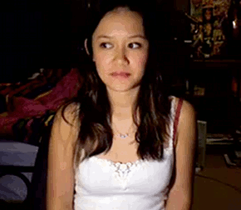
Follow Chi Chapter!
Instagram: @apoucla
#alphaphiomega #aphio #apo #ucla
Tumblr: apochichapter.tumblr.com
Youtube: youtube.com/alphaphiomegachi

Slide 20

Actives, join our committee :)
Newsletter Committee
Alumni Liaison

Slide 21
Membership VP
Jeremy Gozzip & Melissa Ma
membership@apo-x.org

Slide 22
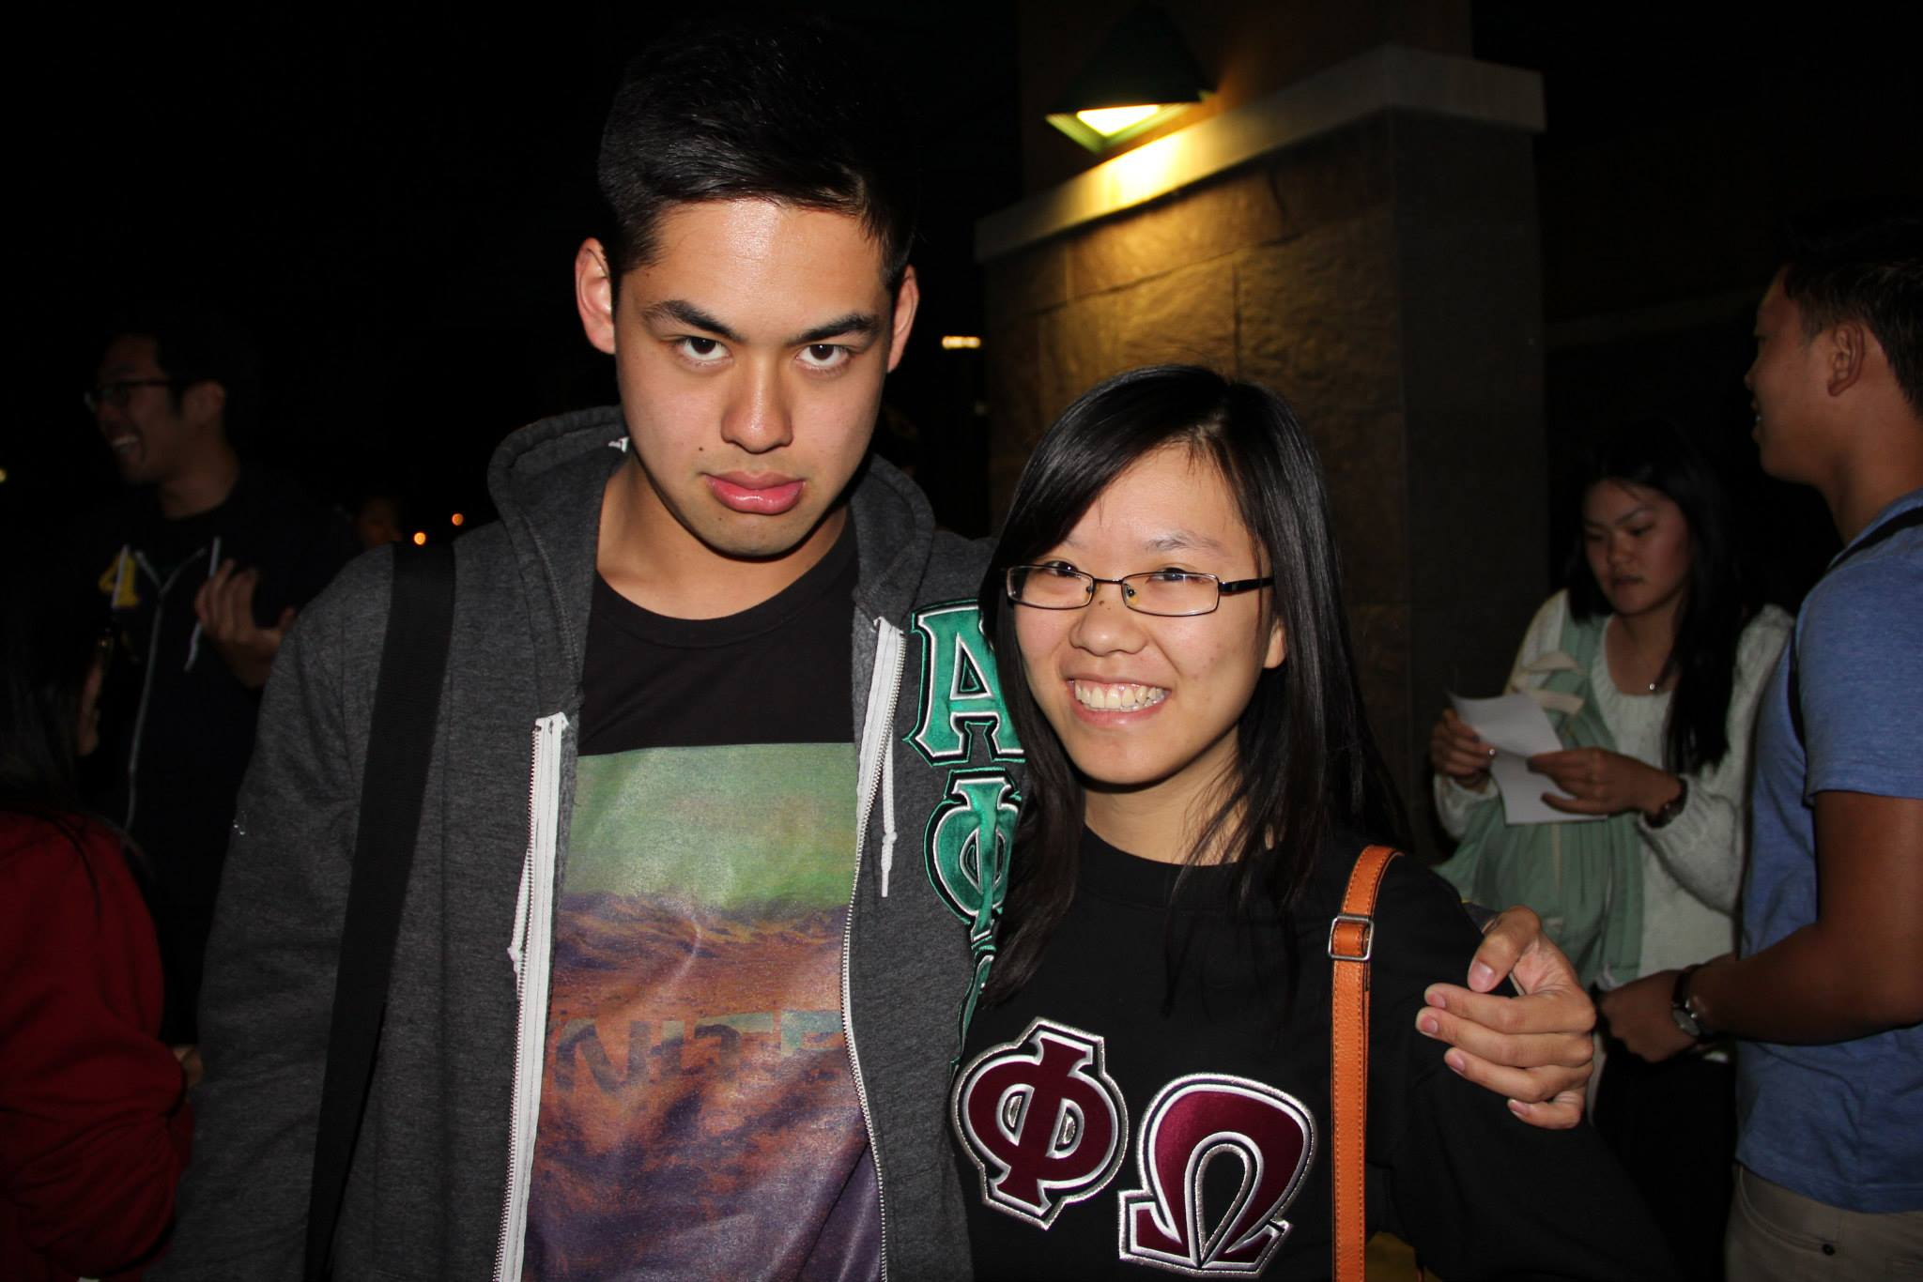
Who are we? What do we do?
We’re Active Parents!
We plan chapter events, oversee Family Heads, Spirit Committee, and other committees
We make sure that your experience as an Active (and Pledge to some extent) is unforgettable and worthwhile
We bring everyone together!
We watch FRIENDS and eat dumplings
We wear matching sweaters (sometimes…)

Slide 23

Active Contracts
Due CM 2
Fill-out a copy
E-mail it to us
List of committees
Everyone needs to be on one to be GOOD STANDING
*DO NOT turn it in late or make us hunt you down.*

Slide 24
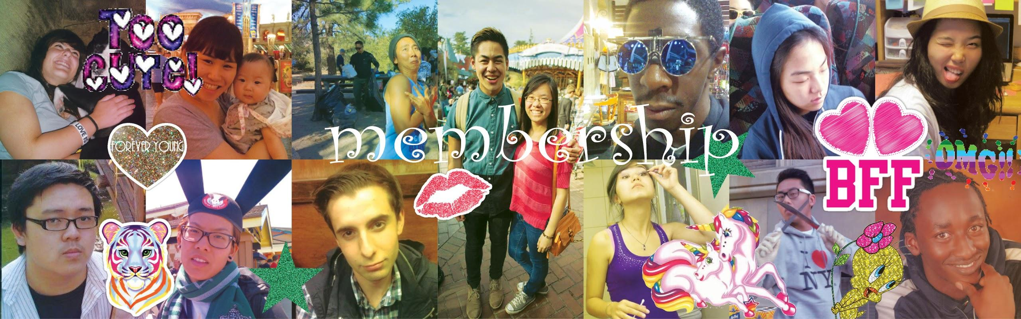

Slide 25
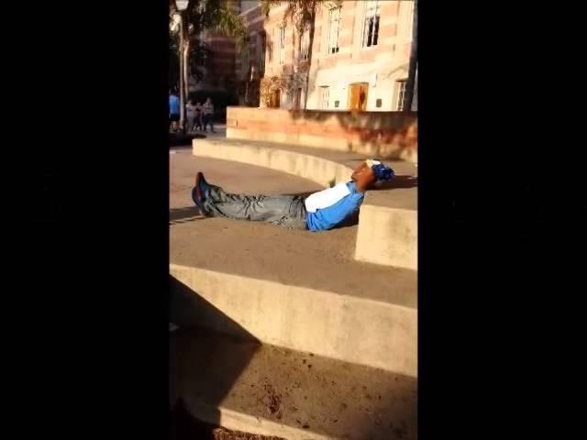

Slide 26
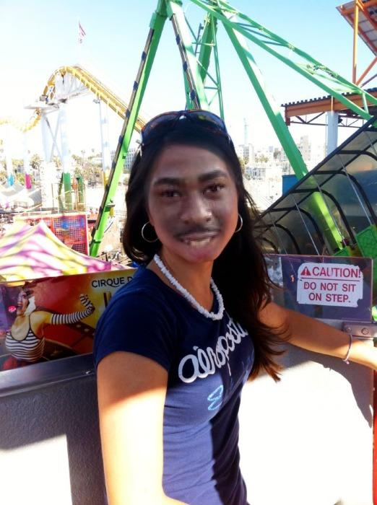
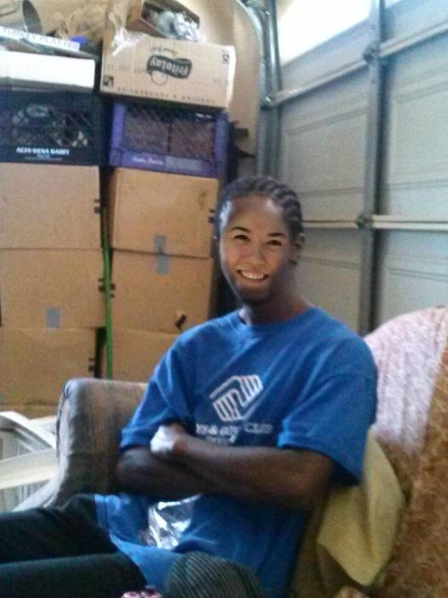
Alpha Family Heads
Abram Summers +
Amy Thelen

Slide 27
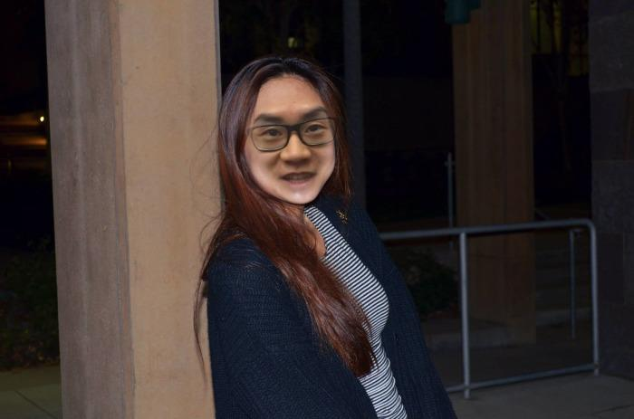
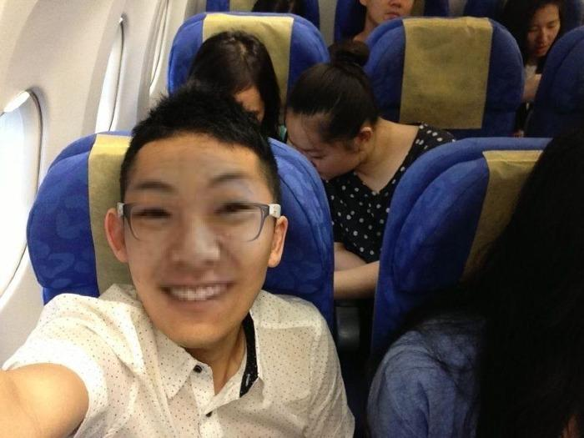
Phi Family Heads
Nathan Cheung + Diane Huynh

Slide 28
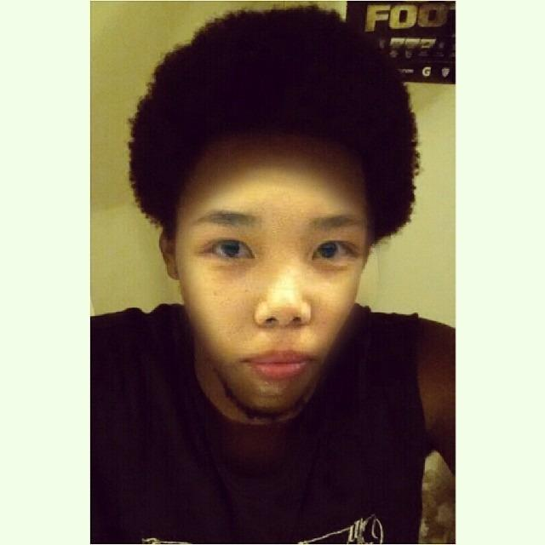
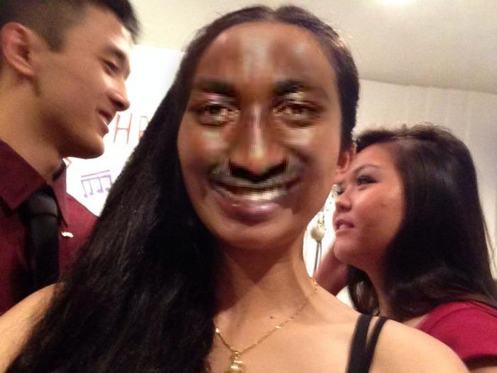
Omega Family Heads
Judy Chen + Sam Nganga

Slide 29


Slide 30
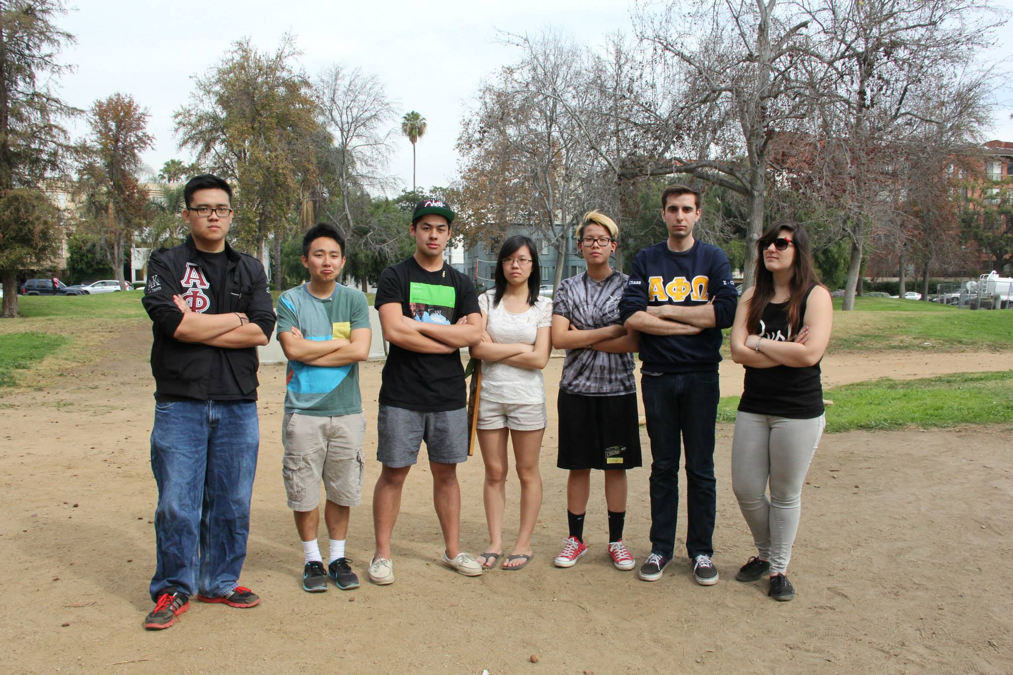
Spirit Committee
Helps plan fun games to play during meetings and chapter events
Foster enthusiasm within the chapter

Slide 31
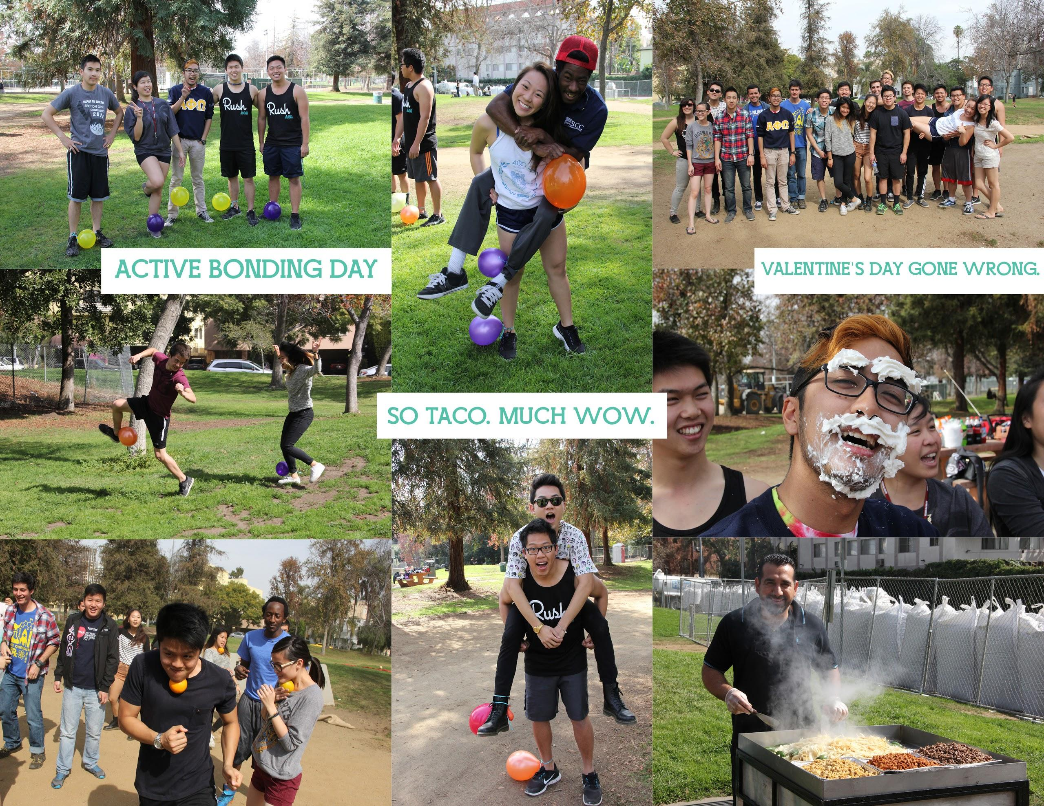
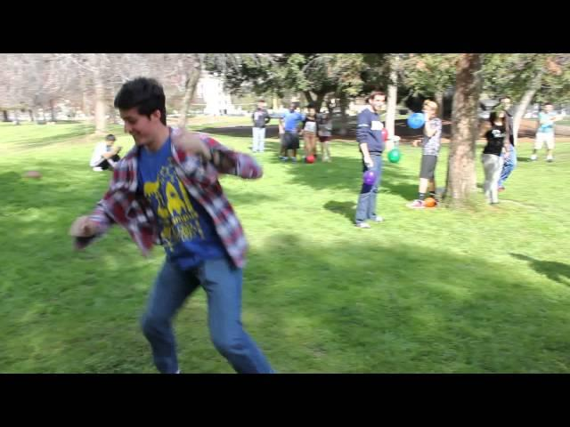
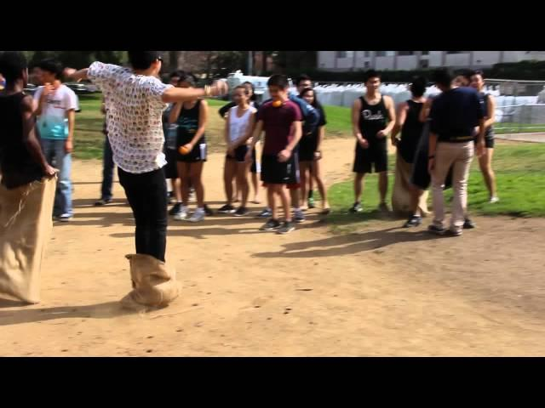
Active Bonding Day
Active Bonding Day
2. 15. 2014
Westwood Park

Slide 32
Shoutout Book
Wanna write a nice message to someone who helped you or someone who you look up to in the chapter?
Write it in the Shoutout Book!
Retention Committee will hold the book in the back of the meeting room for anyone who wants to give a shoutout to a fellow brother/pledge
Each CM, they will pick a message from the book to read in front of the chapter
Spread that CHI love! Give your brothers credit where it is due!

Slide 33
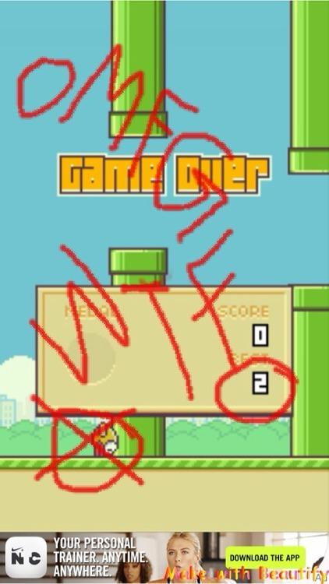

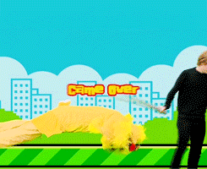
Achievement # 1:
LEVEL 1: Film Flappy Bird or another bird-related cell phone game app in real life (5 ppl, 2 class minimum, 1:30 minimum).

Slide 34
Service VPs
William Nguyen & Jade Vo
service@apo-x.org

Slide 35
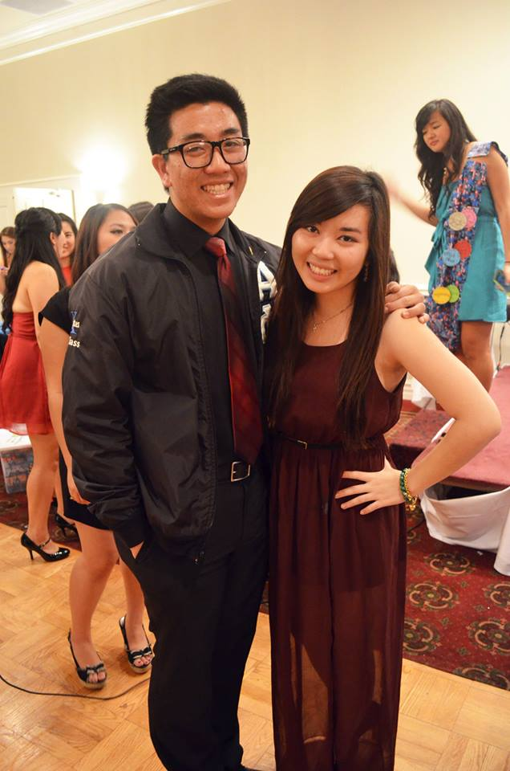

Who We Are!
SERVICE EVENTS!

Slide 36
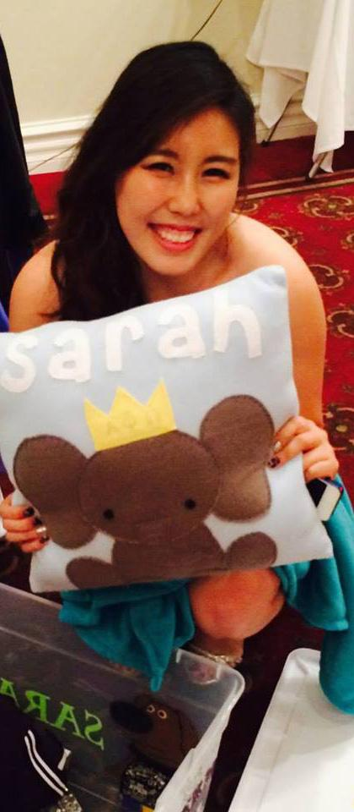
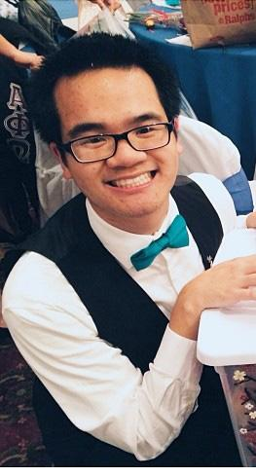
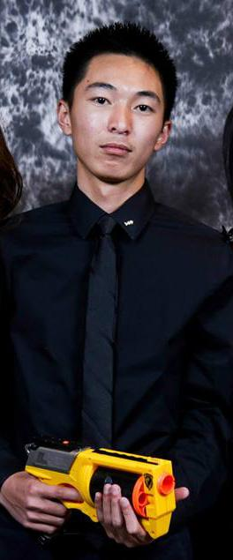
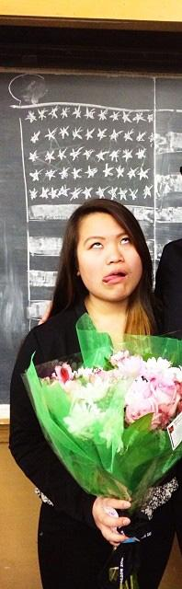
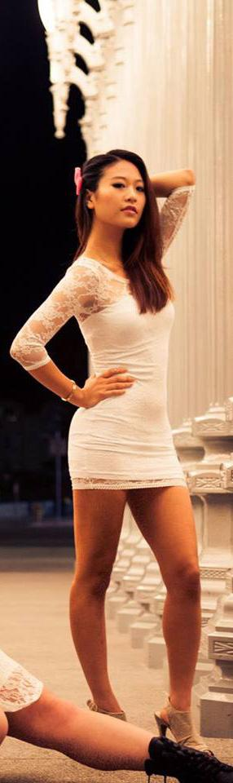

Committees!
Concert!

Slide 37
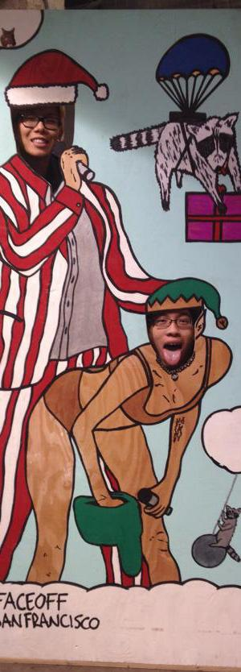
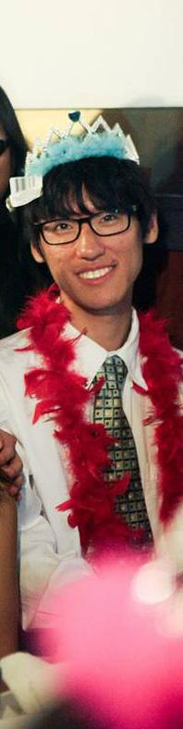
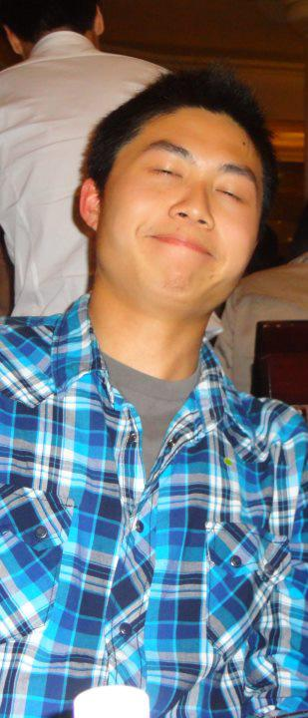
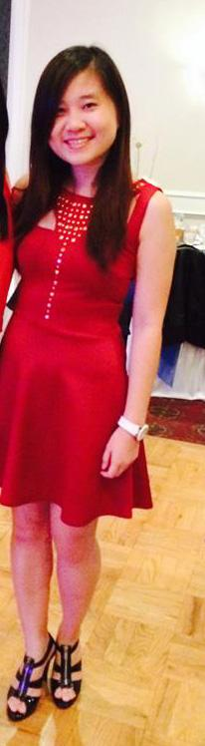

Committees!
Education!

Slide 38
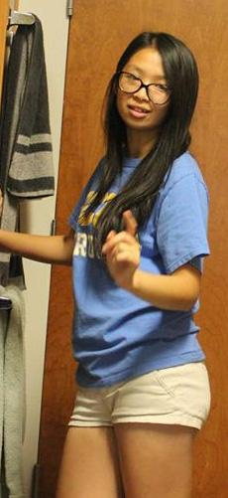
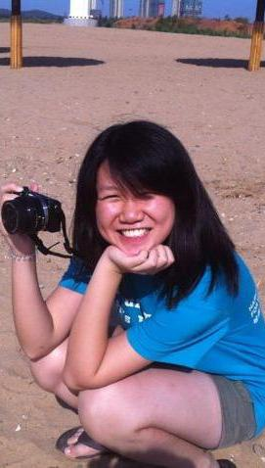
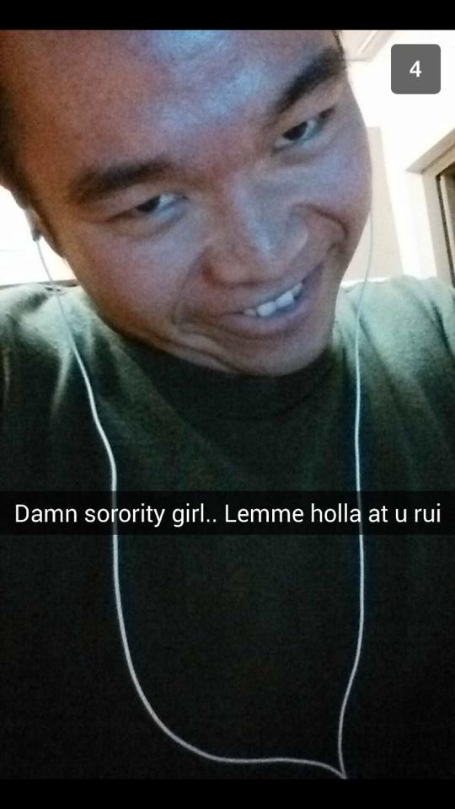
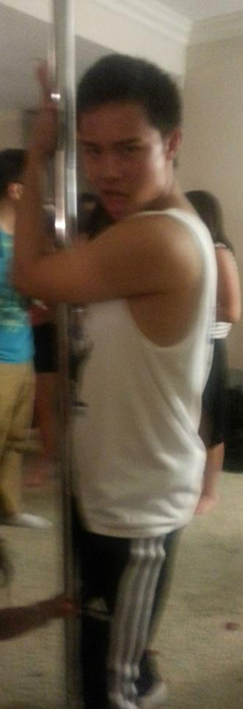
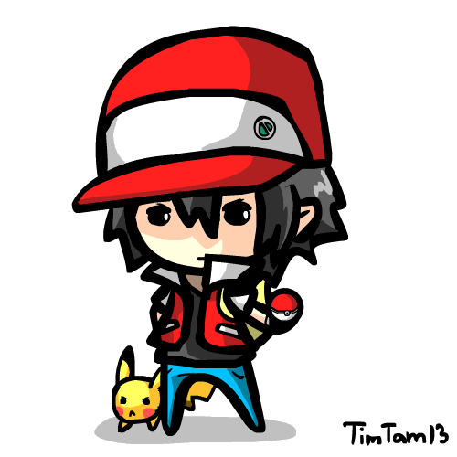
Committees!
Publicity! SBotW!

Slide 39
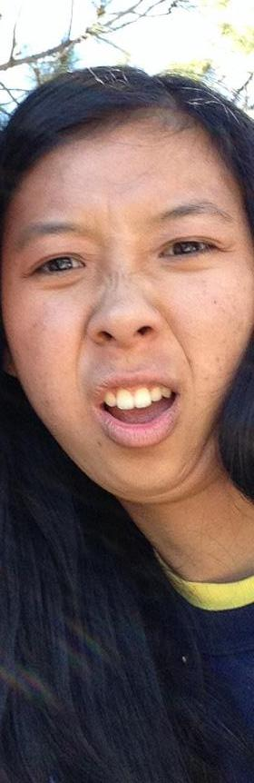
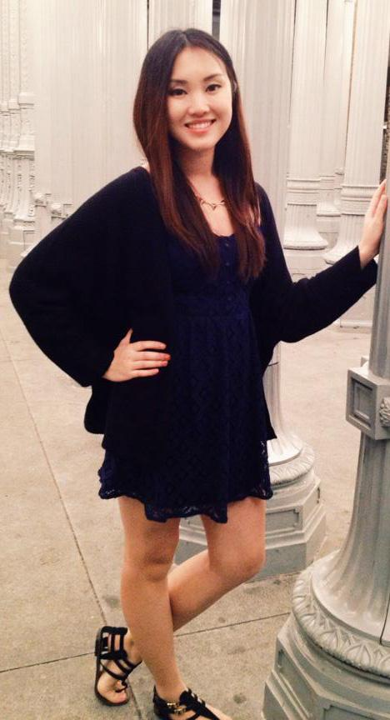

Committees!
Penny Wars! Tracker!

Slide 40


Benefit Concert Update!
What we have so far
What’s planned
Committee!

Slide 41
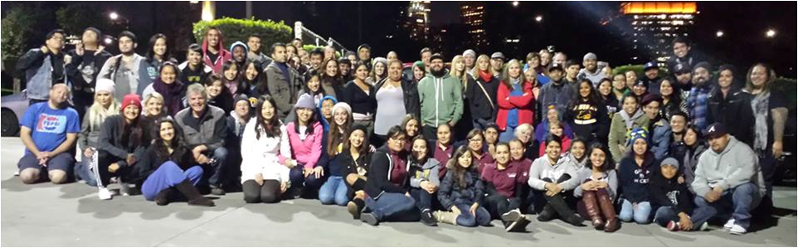
Service Education Time!
Monday Night Mission!http://www.youtube.com/watch?v=i7SGPloGubc

Slide 42
Monday Night Mission
The sole aim of MNM is to feed the less fortunate of Skid-Row who are turned away from Skid-Row shelters
Feed anywhere from 200 to 500 people per night
Not registered, non-profit organization that does not accept any monetary donations

Slide 43

Misc. Announcements
New Policy: Hour Caps
LA Marathon
Project Mataguay

Slide 44
Pledge Parents
Sean Tran & Annie Tran
pledgeparents@apo-x.org

Slide 45
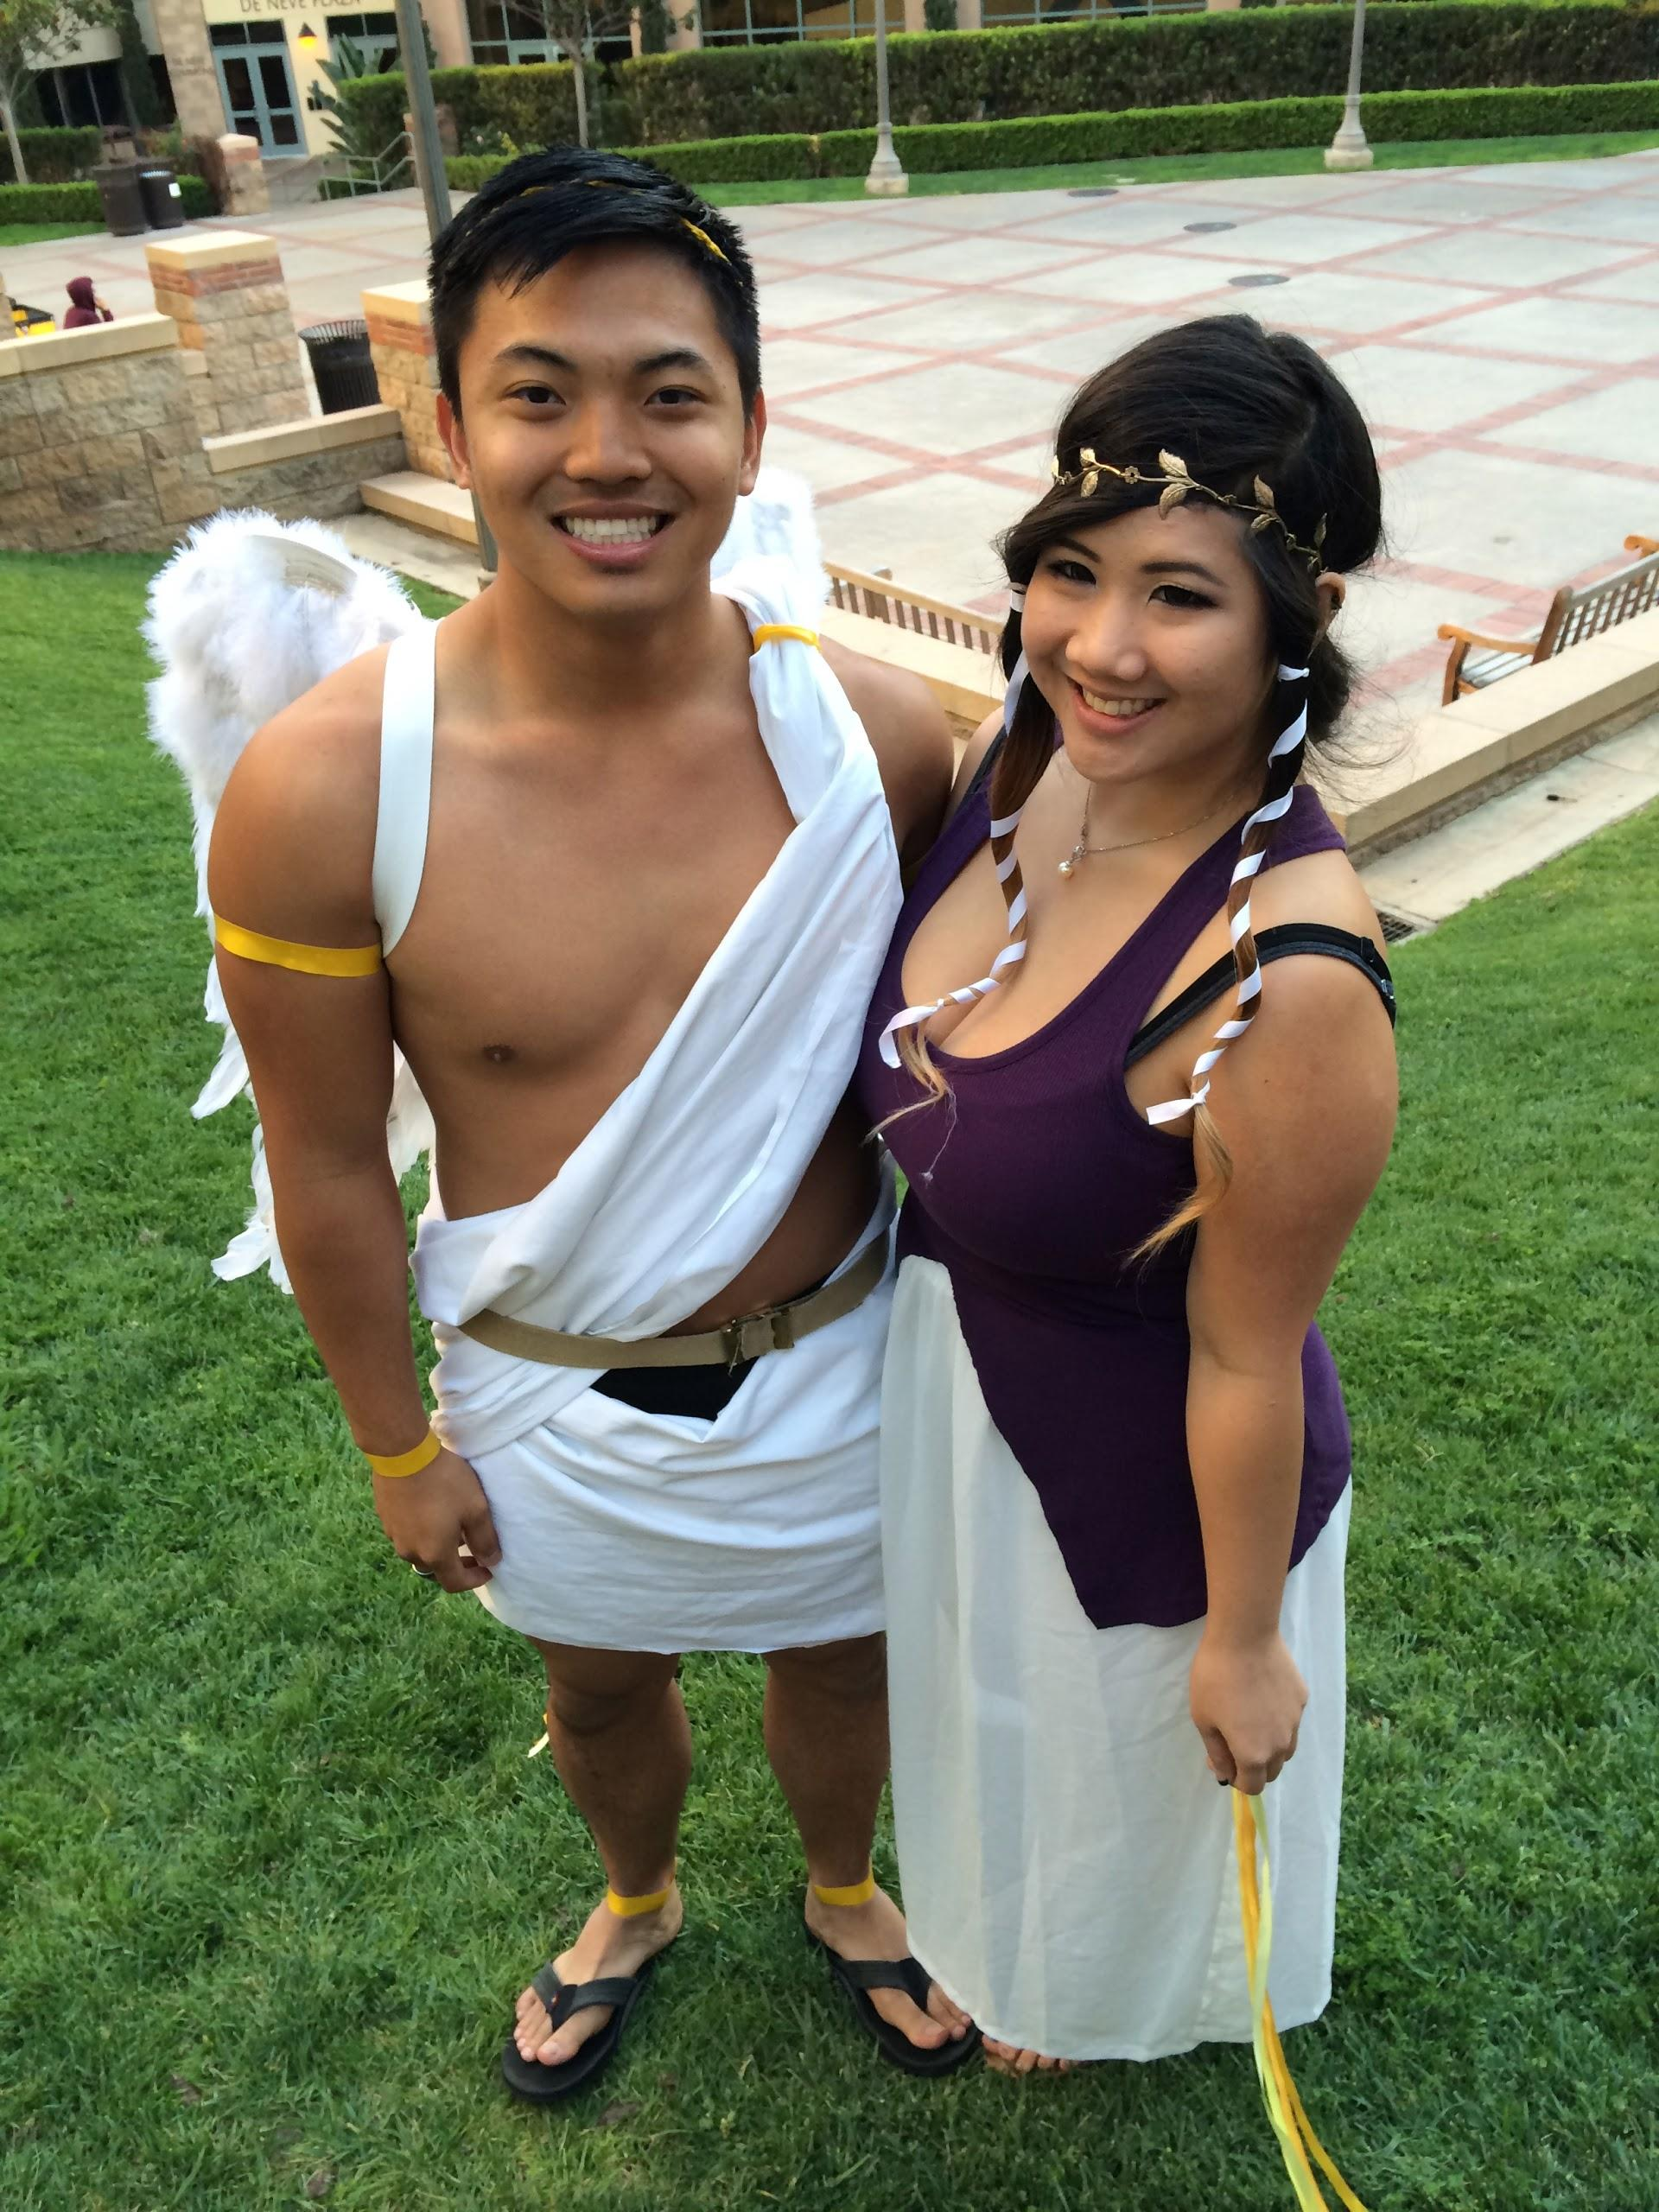

What WE do

Slide 46
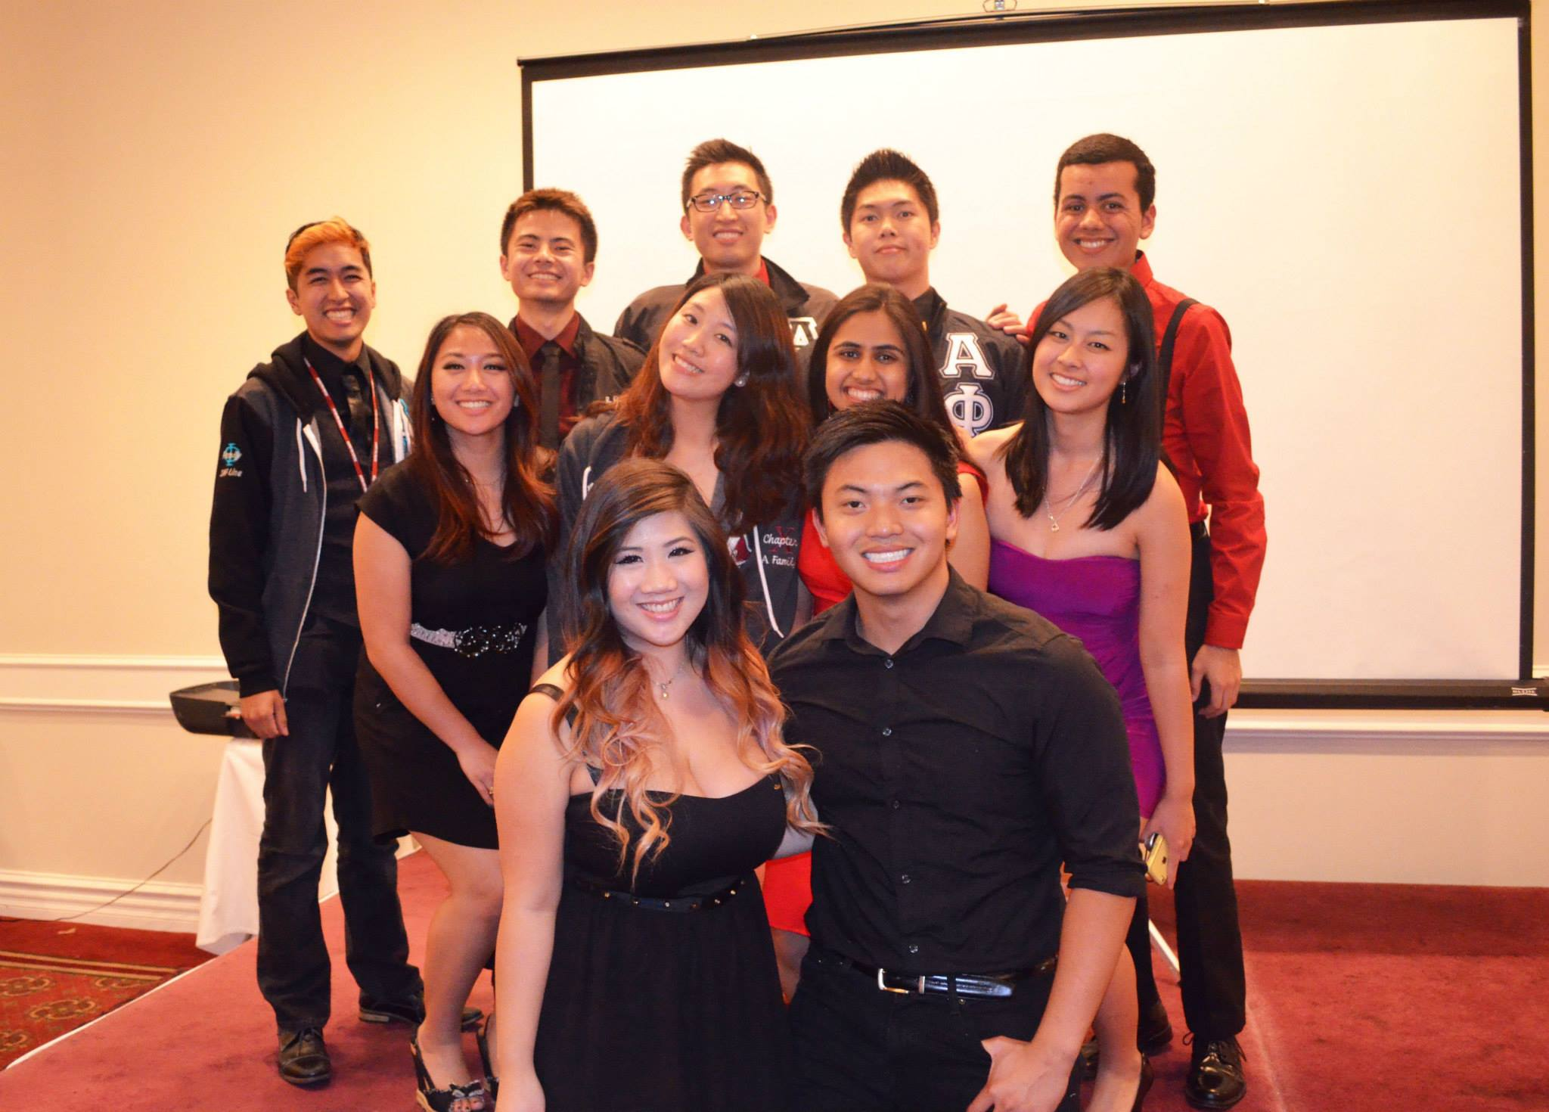
Pledge Advisory Committee
Br
ian

Slide 47
Pledge Update
1st Mission and quiz Interview Etiquette

Slide 48
Finance VPs
Emily Neai-Proeung & Jonathan Liu
finance@apo-x.org

Slide 49
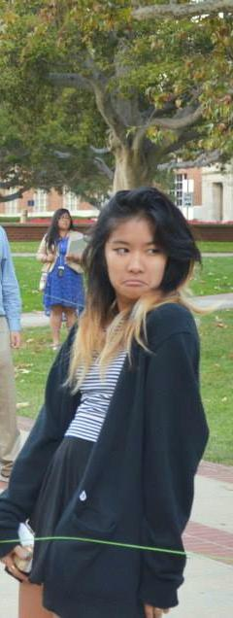
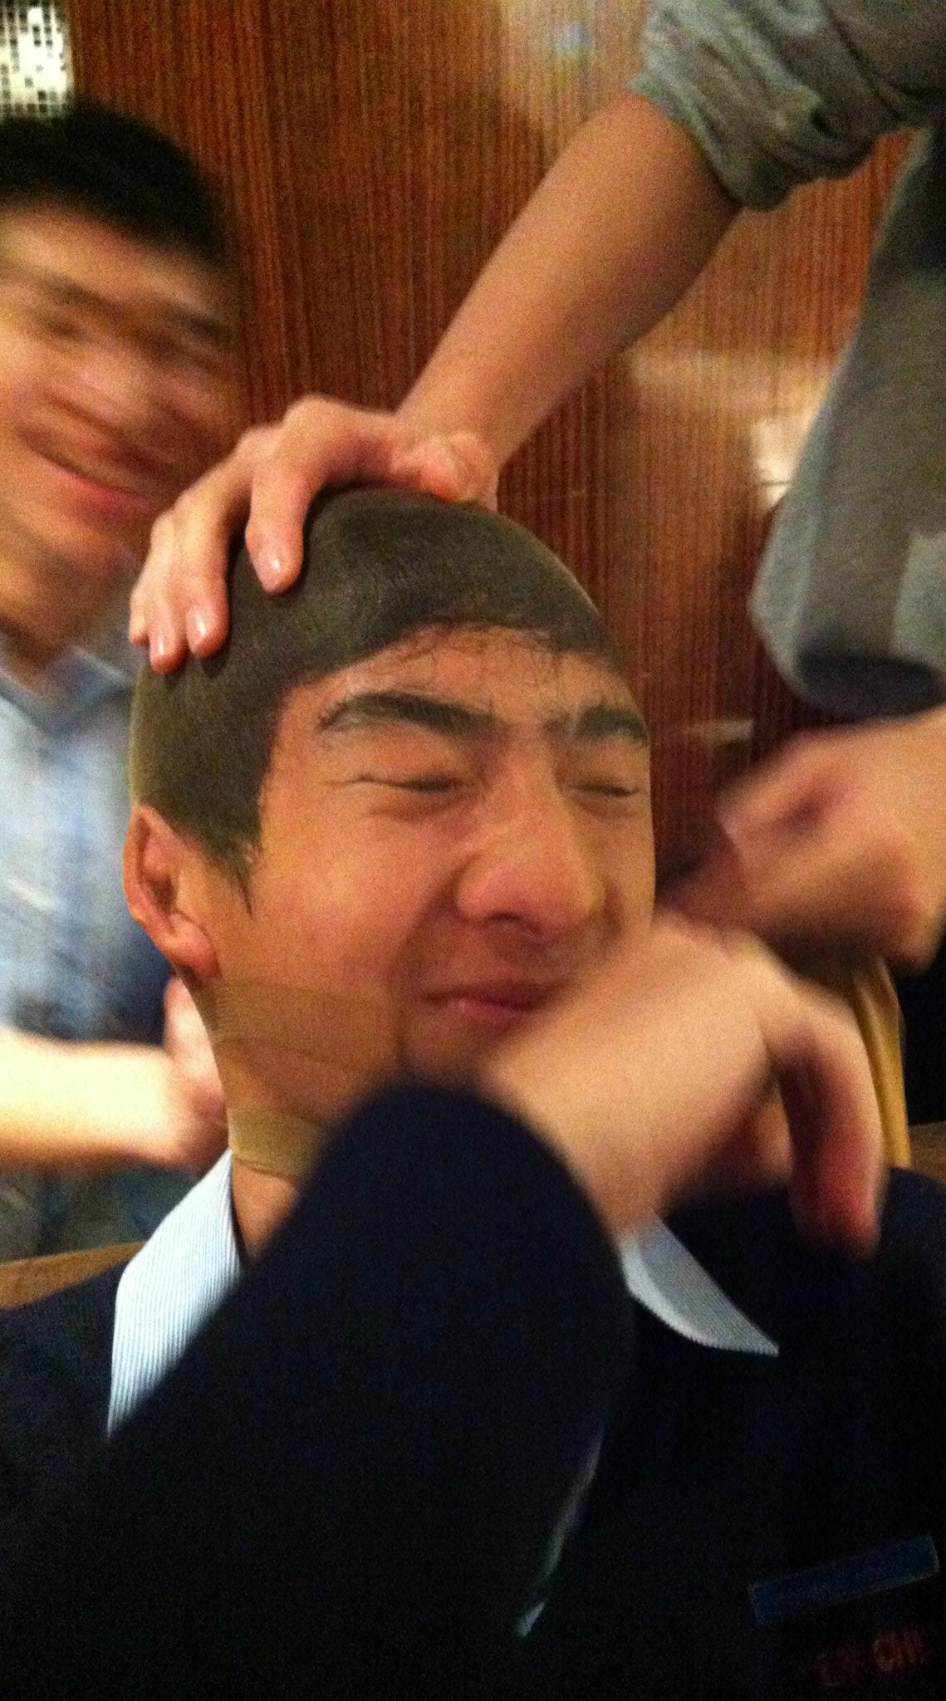
About Us
We deal with anything and everything related to money!
Constructing the Chapter’s budget for this term
Put on fundraisers to raise money towards a cause!
Reimbursements & overseeing financial stability for the Chapter during the term & into the future

Slide 50
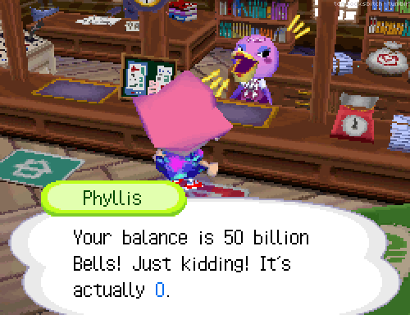
Active Dues
Due by CM2 NO EXCEPTIONS
Active dues: $75
Associate dues: $45
Talk to us if you need the payment plan!

Slide 51
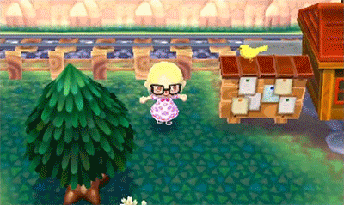
Discount Policy
The policy for discounts is $5 off for every 2 CONSECUTIVE TERMS YOU FINISH GOOD STANDING REQUIREMENTS.
If you go associate or bad standing, the discount resets
The discount is only applicable for good standing dues.
For example:
If you are from the Pledge class Alpha Theta, and you finished both Alpha Iota and Alpha Kappa good standing, then you receive the $5 discount.

Slide 52



Regular Reimbursements

Slide 53


Gas Reimbursements

Slide 54


Fundraising Goals!
All of our proceeds go towards charity
Charity chosen: Autism Speaks!
Predicted minimum amount: $2025
Goal: $2800
FUNDRAISE MORE GUISE

Slide 55

TV Tapings!
Friday 3/7!“Melissa & Joey”
@Paramount Studios
Check the calendar
Sign up ahead of time
Cannot Flake otherwise we lose $$$!

Slide 56

Finance Committees!
Collection Committee (2)
Reimbursement Committee (2)
Fundraising Committee (3)
Tracking Committee (1)

Slide 57

MUCHOS GRACIAS

Slide 58
Fellowship VPs
Michael Hung & Dianne Pham
fellowship@apo-x.org

Slide 59



Who We Are
FELLOWSHIP
(SOCIAL)
EVENTS!

Slide 60





Our Committee
Special Events Committee :D

Slide 61
Open Committee Spots!
Fellowship Assistant (1): Will be in charge of tracking and giving credits for fellowships and aiding the VPs in various tasks.
IM Sports Committee (2): Will be in charge of IM spots and aid in pulling together teams, organizing practices, and morale at games.

Slide 62

Fun Foursies
We’ll be randomizing people into groups of 4
YOUR MISSION: Eat together by CM4.
Two “Foursies” = One fellowship credit
Sign up in the binder today!!
-We will be sorting and emailing groups by next week

Slide 63

Facebook/Binder
https://www.facebook.com/apoxfellowship
Please like us.
Or we will kick you.
Binder is for you guys to give us
ideas or suggestions for
additional events that you all
would like to see up.
Pass it around!

Slide 64

Chi Talent Show!
April 18th. Save the date.

Slide 65
BUCKET LIST
Look on Facebook for details tonight. (:

Slide 66


AND….
TAG US IN YOUR FB PHOTOS!
Check the facebook account for updates regarding:
Upcoming events
Open events
Events that need chairs, drivers, etc.
Beautiful pictures of us
…pls.

Slide 67
IN N’ OUT
Feel free to flake in!
Talk to chairs:
Myha, Bowen, or JT

Slide 68
Historian
Tin Tran
historian@apo-x.org

Slide 69



A little about me...

Slide 70

What I Do
Making awesome webisodes
(I hope T_T)
Brother of the Week
Chi Trivia
Alpha Lambda Termbook
Uploading pictures to APO site

Slide 71

Picture Updates
Online submission through APO
website will be up soon…
Alpha Lambda photos
Albums will be available
through APO website soon...

Slide 72




Pictures!
What kind of pictures should you take?
This one is good... This one is better!

Slide 73

Termbook Update
Active Body Headshots
Please wear Chapter standards T_T
Currently working on :
Excomm section
Pledge section
Active body section
Brothers of Chi Chapter
any suggestions?

Slide 74

Chi Trivia
For pledges only…
What does LFS
stand for?

Slide 75
Chi Trivia
For pledges only…
What does LFS
stand for?
Leadership
Friendship
Service

Slide 76

Chi Trivia
For actives…
Chi Chapter was established in ____ and rechartered in ____.

Slide 77
Chi Trivia
For actives…
Chi Chapter was established in 1931 and rechartered in 1997.

Slide 78

Brother of the Week
Guess who?!
This brother claims to love watermelon, kool-aid, fried chicken.

Slide 79


Brother of the Week
Abram Summers

Slide 80

Brother of the Week
Think a brother deserves to be the next brother of the week?
Nominate them!
Contact
Historian (apoxhistorian@gmail.com)
or Alice Lim (candalice@gmail.com)
or just text us...or something

Slide 81


Meet my committee~
Brother of the Week Committee

Slide 82



Meet my committee~
Termbook Committee

Slide 83


Meet my committee~
Picture Committee
(1 more spot available T_T)

Slide 84


Meet my committee~
Webisode Committee
(1-2 more spots available T_T)

Slide 85

Meet my committee~
Chi Trivia Committee…
(no one yet T_T)
1 spot available
Want to join my committee? :D Contact me!
Any questions?
Just ask~

Slide 86
Sergeant-at-Arms
Catherine Teotico
saa@apo-x.org

Slide 87

What I Do?
Keep order during meetings
Keep track of strikes and give out strikes

Slide 88


Who helps me?
Taylor Briglio and Josh Chin

Slide 89


Evaluation
Evaluations
To receive chairing credit, evaluations must be completed within 3 calendar days of the event start date.
Under chair tools, Click on the Chair Submission Form
1. Please follow instructions thoroughly.
2. Event description:
1. Task and activities done during the event
2. How the participants responded to the event
3. Strengths and weakness of the event
4. Your advice for the future if this event is to be repeated.
All event descriptions must answer each question
Chair can still have freedom to make the evaluation funny, creative etc.
Email event pictures attached to: Historian
Email dollar amount made by each participant to: Finance

Slide 90
Lateness
Late: failure to arrive at the meeting location by the prescribed time.
Event chairs shall enforce this policy for all official events.
An optional 5-minute grace period may be allowed at the chair's discretion.
Arriving after the grace period (if any) shall result in a late mark in the event evaluation.

Slide 91
Chapter Meeting
Coming late to meeting:
If an Active arrives to meeting more than 5 minutes after the President calls the meeting to order, that Active will be considered late.
Must notify SAA by 6:00pm and must be a valid excuse (as determined by SAA)
Must come before 7:30pm and stay for the duration of the meeting to obtain meeting credit.
No strike will be given if SAA is notified appropriately.
If an Active comes before 7:30pm, but does not notify SAA properly and stays for the entire meeting, then he/she will get 0.5 strikes for the first offense and 1 strike for each additional offense. The active will receive 1 meeting credit.
If an Active comes after 7:30pm and does not notify SAA properly then he/she will get no meeting credit but no strike.
Leaving early from meeting:
Must notify SAA by 6:00pm and must be a valid excuse (as determined by SAA)
Must stay for an entire hour.
Must show up on time (cannot come late and leave early during the same meeting).
No meeting credit will be given to any active leaves before 8:00pm
You need to notify SAA if the actives leaves after an hour but before the end of the meeting

Slide 92
Flakes
Flake: missing an event that you are signed up for without a replacement.
A flake shall result in one negative credit for that event (or for each hour, if service; for each dollar, if fundraising).
Flaked events (or service hours) must be made up IN ADDITION TO completing requirements. (Ex: If you have completed 13 hours of service and flake a 5 hour service, your total completed service hours will then drop to 8 hours. If you have already completed your requirements, but decide to flake an event, then you must make up that flaked event regardless of how many you will have after the deductions.
Note: It is possible to accrue negative hours/credit
An Active brother may make up a missed Chapter meeting by attending the Excomm meeting prior to that missed meeting. Actives must notify the Sergeant-at-Arms at ExComm meeting about making up a meeting credit. A one-page, double-spaced, size 12 Times New Roman write-up must be submitted to SAA.
Flaking in: attending an event without being signed up for it.
You must contact the chair prior to attending.
By flaking in, you may possibly save a flaked attendee from any penalties.
Be considerate: you need to account for space, rides, activities, etc.
If you just show up, you might be able to attend or get credit, but do not expect it.

Slide 93

Strikes
Strikes can be received for:
Flaking an event (1 strike)
Arriving late to an event (0.5 strike)
Unexcused late/leaving early from meeting (0.5 strike for first offense, 1 strike for second offense and after)
Failure to wear letters or pins when necessary (1 strike)
Failure to chair properly (at the discretion of the Sergeant-at-Arms) (1 strike)
Loudness/distractions at meeting (1 strike for each offense after the third warning)
All Strikes must be reported to
https://docs.google.com/forms/d/15hDRID6nJxN9ZJtRVadMY7qkQ0o_6vnExG2bfXD4Kw8/viewform

Slide 94
Strikes Make-Ups
Strike make-ups
Paying the Sergeant-at-Arms $2 will remove a letter/pin strike.
There are two options for making up strikes for Actives:
LFS: 1 chair/workshop + 1 friendship event + 1 hour of service
3 hours of service
·
In order to receive strike make-up, you must:
Notify SAA prior to beginning that you are completing strike make-up.
Comment on event page, stating that you are applying those event credits towards strike make-up instead.
Not receive normal event credit towards requirements for these events.

Slide 95
Pins
Pin: worn by APO brothers and pledges.
Must be visible
Must be worn on clothing, on collar or collar area, on outer most layer
Not worn on ear, hoodie string, bra strap, or fly
Actives
Actives must wear their pin OR wear a shirt/sweater displaying the fraternity letters at all official APO events for the entirety of the event.
Chair of event must note missing pins/letters in evaluation.
Sergeant-at-Arms will be responsible for tracking.
Pledges
Pledges must wear their pin at all times, except during the Three S's (shower, sports, sleep); however, the pin must be WITH the pledge at all times.
If at an event, chair must note in evaluation and notify Pledge Parent(s). Pledges will receive a half-strike if found without a pin.

Slide 96

Pins
Pin Replacement
Report Lost Pins to Sergeant-at-Arms immediately
All lost pins must be reported to
https://docs.google.com/forms/d/1VadIGN4NbwgZXs_bfGj2O_-NJL0CnDGEq5SFJa4Pd5g/viewform
The timestamp on the Google doc will be the time SAA will follow.
If the active reports to SAA that a pledge/active needs to be striked before the pledge/ active reports on the Google doc said person will be struck.
Pins may be purchased for $5 from the Sergeant-at-Arms.

Slide 97
Card Strike Policy
Instead of the poop list and the kiss list that has been the staple of the keeping order in the meeting, we are moving to the card strike policy due the distraction that the list creates.
All actives and pledges will be subject to this procedure
1st offense = Yellow Card
2nd offense = Orange Card
3rd offense = Red Card and 1 Strike
Due to ongoing problem that the same people are the ones continually disrupting meeting, we will be enforcing this policy
6 Yellow Card in a Quarter Term = 1 Strike
3 Orange Card in a Quarter Term = 1 Strike
Red Cards will not carry over.
Other combinations will not receive a strike like 2 Orange and 1 Yellow, etc.
Exceptions will be given out through the meeting for specific instances that members may engage in conversation
During a game
A change in the amendment, etc. that needs discussion
Other instances at SAA discretion

Slide 98

ABEA...
Started by Our Namesake Yuna Choi
Stands for America’s Best Evaluation Award
This prestigious award goes to the Person who did the best evaluation obviously
This week, It goes to….

Slide 99

Bryan Park!!
For this service event, us brothers' responsibilities were to help provide more of an active presence to wheelchair basketball as a sport. We definitely helped contribute to greater awareness of this game by how much we enjoyed playing as team players for the night. This wheelchair basketball was overall a really fun, and really active and enjoyable service event. Each of the attendees were divided into two teams, and worked with the fellow wheelchair players, who were really good. And each of us were really good at playing in our own respective ways. Throughout the service event, each of the attendees contributed actively into each game that we played, and certainly made each of the matches very exciting for their respective teams. I love Cindy's competitive edge to win. Cindy's team loved Cindy; they loved how she was really good at stealing the ball and making shots from time to time. I love Nathan and how well he shot the baskets when the ball was given to him, such as when he made two shots in a game. I definitely loved Jonathan Liu's determination and how his team relied on him. Jonathan played a huge role by always getting closer to the basket, which increased his chances of getting the shots in when his fellow team mates passed the ball to him, showing his readiness to help his team. His level of persistence in winning and his contributions to the game was very noteworthy, as he was really in-sync with the rest of his team players. I absolutely loved Sarah and how much she was also there for her team. always keeping the games very lively with her high energy. There were no weaknesses to the event, as we all loved playing with our peers, making sure that we understood what we needed to do and how well each of my attendees worked with their respective team players. I appreciated how much each of my attendees consistently smiled and communicated as well as worked diligently with their team players. We all definitely enjoyed contributing as much as we could to the games with our keen eyes, strong awareness of what is going on, who has the ball, always in our ready positions at every second and every minute of the games, communicating with our team mates really well, and providing good sportsmanship. Our brothers were thoroughly very active and were really into waning to win, which really made the wheelchair game again more exciting to watch. They were really into it, which made this service event more enjoyable and more of a competitive game that was a lot of fun to be in. Overall, wheelchair basketball was a very fun and successful service event through our efforts, through showing our cooperation from how much we kept the games as competitive and lively as possible, and our eagerness to help our team make each and every winning shot count. This was a really good service event.

Slide 100
Interchapter Chair
Olivia Pardo
interchapter@apo-x.org

Slide 101



What I do ^__^
Liaison between our chapter and other chapters
Making events so you guys can meet all kinds of people

Slide 102




IC Dance Comp
Practice @ 10PM in Wooden Center
Talk to me if you still want to join!

Slide 103


Slide 104

Project Mataguay
Annual IC service retreat with friends, activities, food, and more!
March 7-9, 2014
Registration closes on Sunday @ 11:59M

Slide 105

Section 1 Conference
April 5, 2014
UC Riverside
Early Bird ends on Sunday
Conference: $25
Banquet: $30
Combo: $50

Slide 106

Interchapter Etiquette

Slide 107
Chair of the
Advisory Committee
Kevin Lee
cac@apo-x.org

Slide 108
CAC Office Hours
In-Person or Virtual OH on Sundays (or schedule in advance please)
Phone Number: (714) 916 - 8005
E-mail: apoxcac@gmail.com
Chat: Facebook or Gchat

Slide 109
Alumni Counselor Program
Interested in having an alumni counselor related to your career field/interest?
Be on the lookout for an e-mail from me by next week!
When reaching out to an alumni member, be respectful and professional.
Not all participating alumni are local!
Have FUN! :)

Slide 110
Professional Career Workshops
Microsoft Excel Workshop (WED - 3/5)
Beginners
Bring a charged MS Excel Installed laptop
Resume & Networking Workshop (TUES - 3/11)
Event capped at 8
PPP [Powerpoint, Public Speaking, Presentation] Workshop (Next Quarter)
More to come!

Slide 111
Risk Management Policies

Slide 112
Hazing
No fraternity member shall take part in hazing activities.
Any action taken or situation created, intentionally, whether on or off
fraternity premises or during fraternity functions, to produce mental
or physical discomfort, embarrassment, harassment or ridicule… any other
activities which are not consistent with fraternal law, ritual or policy or the
regulations and policies of the educational institution and local, state and
federal laws

Slide 113
Sexual Harrassment/Abuse/Discriminiation
The Fraternity will not tolerate or condone any form of abusive or discriminatory behavior on the part of its members, whether physical, mental or emotional
in respect to sex, race, ethnicity, physical or emotional handicap, age, marital status, sexual orientation, gender identity, or religious affiliation.

Slide 114
Contractual and Financial Issues
No chapter, alumni association, section or region shall enter into a contract or financial agreements using the specific name of Alpha Phi Omega.
Qualifying statements as to which chapter, alumni association, section, or region must accompany all agreements entered into for the purposes of supporting fraternity functions. This includes, but is not limited to, such agreements as leases, contracts, hold harmless agreements, liability releases, account agreements, purchase orders, and hotel or banquet contracts.

Slide 115
Alcohol and Drugs (Substance Abuse)
The possession, use and/or consumption of alcoholic beverages, during any Fraternity event, any event that an observer would associted with the Fraternity, or in any situation sponsored or endorsed by the chapter, must be in compliance with any and all applicable laws, policies and regulations of the state, county, city and institution of higher education. The unlawful possession, sale and/or use of any illegal drugs or controlled substances at any Fraternity sponsored event, or at any event that an observer would associate with the Fraternity, is strictly prohibited.

Slide 116
Personal Property
Use of personal property in fraternity activities shall be strictly voluntary and the sole responsibility of the owner. Alpha Phi Omega shall not assume liability for personal property used in conjunction with fraternity activities, nor for any damages resulting from said use.

Slide 117
Transportation Issues
Any individual who drives or otherwise provides transportation in conjunction with Alpha Phi Omega activities shall obey all applicable motor vehicle laws, including, but not limited to, those concerning vehicle safety, vehicle operation, insurance and the transportation and consumption of alcoholic beverages. Operators will ensure that vehicles are not overloaded and are driven in a safe manner. Rental vehicles shall be operated in accordance with rental contracts.
Use of personal vehicles shall be strictly voluntary and the sole responsibility of the vehicle owner/operator. Alpha Phi Omega shall not assume liability for personal vehicles used in conjunction with Fraternity activities, nor for any damages resulting from said use.

Slide 118
General Health & Safety
All activities planned in conjunction with Alpha Phi Omega shall take into account the health and safety of all participants. Planning of Alpha Phi Omega projects and activities will include appropriate personal safety
equipment (ear plugs, eye protection, gloves, etc.), training (use of tools and equipment), and supervision. All equipment to be used in conjunction with Alpha Phi Omega activities will be in good working condition and will be used in a safe manner.

Slide 119
Advisors
Advisors and alumni serving Alpha Phi Omega on behalf of their employer or respective volunteer agency (educational institution, youth service organization, etc.) will do so in accordance with the policies of said entity, including but not limited to risk management and personal liability

Slide 120
Education
All reasonable efforts will be made to insure each student member, pledge, associate member, advisor, alumnus and honorary member shall be instructed on the Risk Management Policies annually.
SOOOOO….

Slide 121
Raise Your Right Hand :)
As a member of Alpha Phi Omega Chi Chapter, I hereby understand the Standard Risk Management Policy set by the fraternity. I affirm and commit to the responsibilities set by the fraternity.

Slide 122
Last Announcements

Slide 123

Marina is back this week!!

